Slide 1
Transport Layer
Chapter 6
Transport Service
Elements of Transport Protocols
Congestion Control
Internet Protocols – UDP
Internet Protocols – TCP
Delay-Tolerant Networking

Slide 2

The Transport Layer
Responsible for delivering data across networks with the desired reliability or quality
Provide data support from a process on a source machine to a process on destination machine
Application Transport
Network Link Physical

Slide 3
The OSI reference model.

Slide 4
Transport Service
Services Provided to the Upper Layer »
Transport Service Primitives »
Berkeley Sockets »
Socket Example: Internet File Server »

Slide 5
Services Provided to the Upper Layers (1)
Goal
To provide efficient, reliable and cost-effective data transmission service to its users, i.e., to a process in the application layer
Transport layer adds reliability to the network layer and offers
connectionless (e.g., UDP) and
connection- oriented (e.g, TCP) service to applications
The network, transport, and application layers.

Slide 6
Why different layer?
Transport service is similar to network layer. Then, why two distinct layers?
Transport layer runs entirely on users machine
Network layer runs on routers, which are operated by the carrier.
What happens if the network layer offers inadequate service?
What if it frequently loses packets?
What happens if the routers crash time to time?

Slide 7
About Transport Layer
Essence of the transport service
More reliability to applications
Users have no control over network layer.
Transport layer can use retransmissions.
Transport primitives are independent of network primitives.
Network service calls may be different for each network
(a)Environment of the data link layer. (b)Environment of the transport layer.

Slide 8
Transport Service Primitives (1)
Example:
Two processes in a single machine connected through a pipe
Process A puts the data and Process B consumes
Connection between them is 100 % perfect
No acks, no lost packets, congestion or any thing.
Transport layer provides similar service in the network for connection-oriented service with acks, lost packets, congestion and other mechanisms
Transport layer also provides unreliable datagram service
Another difference
Network service is used by transport entities
Few users write their own transport entities
Few users writes programs using network services
Many programs use transport primitives.

Slide 9
Transport Service Primitives (1)
Primitives that applications might call to transport data for a simple connection-oriented service:
Client calls CONNECT, SEND, RECEIVE, DISCONNECT
Server calls LISTEN, RECEIVE, SEND, DISCONNECT
Primitive | Packet sent | Meaning
LISTEN | (none) | Block until some process tries to connect
CONNECT | CONNECTION REQ. | Actively attempt to establish a connection
SEND | DATA | Send information
RECEIVE | (none) | Block until a DATA packet arrives
DISCONNECT | DISCONNECTION REQ. | Request a release of the connection
The primitives for a simple transport service.

Slide 10
Transport Service Primitives (1)
LISTEN: calling a library procedure that makes a system call that blocks the server until a client tuns up.
CONNNECT: When client wants to talk to the server, it executes a CONNECT primitive. It results into CONNNECT REQ. segment sent to the server.
The server unblocks the server and sends CONNECTION ACCCEPTED segment back to the client.
Data can be exchanged using the SEND and RECEIVE primitives.
Every data packet is acknowledged.
When a connection is no longer needed, transport user issues a DISCONNECT primitive. Upon the arrival, the connection is released.
Each direction is closed independently.

Slide 11
Services Provided to the Upper Layers (2)
Segments are contained in the packet sent by network layer, in turn packets are contained in frames exchanged by data link layer.
Nesting of segments, packets, and frames.

Slide 12
Transport Service Primitives (2)
State diagram for a simple connection-oriented service
A state diagram for a simple connection management scheme. Transitions labeled in italics are caused by packet arrivals. The solid lines show the client's state sequence. The dashed lines show the server's state sequence.

Slide 13
Berkeley Sockets
Very widely used primitives started with TCP on UNIX
Notion of “sockets” as transport endpoints
Like simple set plus SOCKET, BIND, and ACCEPT
Primitive | Meaning
SOCKET | Create a new communication endpoint
BIND | Associate a local address with a socket
LISTEN | Announce willingness to accept connections; give queue size
ACCEPT | Passively establish an incoming connection
CONNECT | Actively attempt to establish a connection
SEND | Send some data over the connection
RECEIVE | Receive some data from the connection
CLOSE | Release the connection
The socket primitives for TCP.

Slide 14
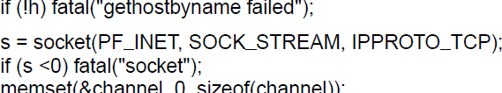
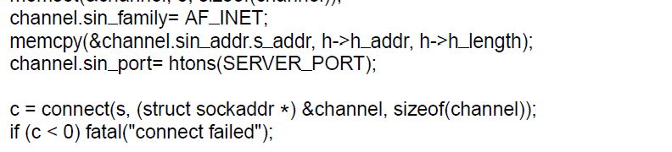
Socket Example – Internet File Server (1)
Client code
. . .
Get server’s IP address
Make a socket
Try to connect
. . .

Slide 15
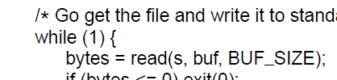
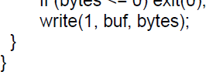
Socket Example – Internet File Server (2)
Client code (cont.)
. . .
Write data (equivalent to send)
Loop reading (equivalent to receive) until no more data; exit implicitly calls close

Slide 16
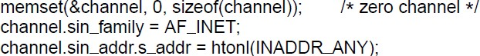
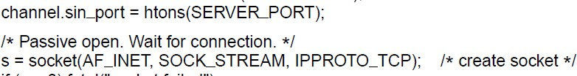
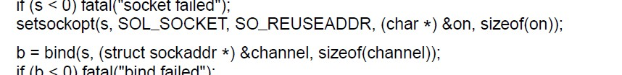
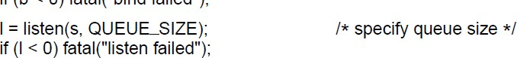
Socket Example – Internet File Server (3)
Server code
. . .
Make a socket
Assign address
Prepare for incoming
. . .
connections

Slide 17
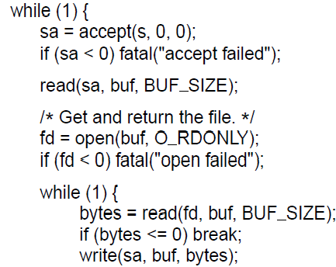
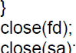
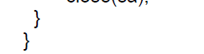

Socket Example – Internet File Server (4)
Server code
. . .
Block waiting for the next connection
Read (receive) request and treat as file name
Write (send) all file data
Done, so close this connection

Slide 18
Elements of Transport Protocols
Addressing »
Connection establishment »
Connection release »
Error control and flow control »
Multiplexing »
Crash recovery »

Slide 19
About Transport Protocols
Transport protocols resemble data link layer protocols
Both have to deal with error control, sequencing, and flow control, among other issues
Significant differences exist due to environmental differences
Differences
One: Data link layer is on direct connection whereas transport layer is on entire network.
Two: Delay is more in transport layer, more failures
Three: Number of connections are more in transport layer
(a)Environment of the data link layer. (b)Environment of the transport layer.

Slide 20
Addressing
Transport layer adds TSAPs (Transport Service Access Points)
Multiple clients and servers can run on a host with a single network (IP) address
TSAPs are ports for TCP/UDP
TSAPs, NSAPs, and transport connections.

Slide 21
Process server: inetd in UNIX
Each machine runs a special process server.
The process server spawns a thread and connects to the related server.
How a user process in host 1 establishes a connection with a mail server in host 2 via a process server.

Slide 22
Connection Establishment (1)
Key problem is to ensure reliability even though packets may be lost, corrupted, delayed, and duplicated
Don’t treat an old or duplicate packet as new
(Use ARQ and checksums for loss/corruption)
Key issue
Delayed duplicates
User sends packets, they may follow longest route.
User time out expires. Send the packets again.
Receiver receives both old and new packets
Approaches
Restricted network login
Putting a hop counter in each packet
Timestamping each packet
We should also ensure that all ack. are dead.

Slide 23
Connection Establishment (1)
Approach:
Don’t reuse sequence numbers within twice the MSL (Maximum Segment Lifetime) of 2T=240 secs
We can use the clock
Once the transport entities agree to initial sequence number, any sliding window protocol can be used.
It discards duplicate packets
Issues
How to keep packet sequence numbers out of forbidden region?
If the host sends too much data too fast, it results sequence numbers to enter into forbidden curve.
If the data rate is less than the clock rate, we also get into the trouble.
We have to remember the sequence numbers.
Three-way handshake is proposed to solve the problem

Slide 24
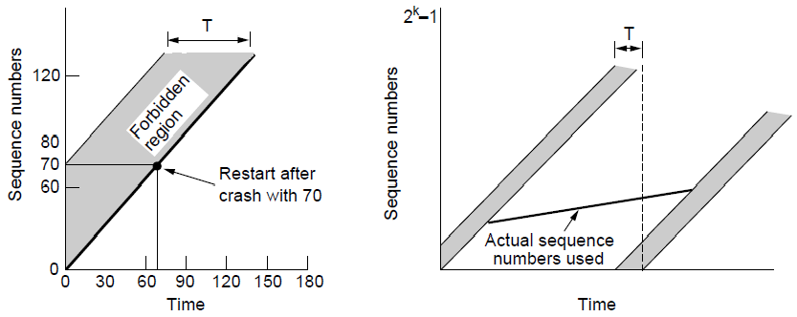
Connection Establishment (2)
Use a sequence number space large enough that it will not wrap, even when sending at full rate
Clock (high bits) advances & keeps state over crash
Need seq. number not to wrap within T seconds
Need seq. number not to climb too slowly for too long

Slide 25
Connection Establishment
Three-way handshake used for initial packet
Since no state from previous connection
Both hosts contribute fresh seq. numbers
CR = Connect Request
Protocol
Host 1 choses a sequence number and sends CR
Host 2 send CR with ack. and sending its own sequence number.
Host 1 ack. the choice of sequence numbers by host 2

Slide 26
Connection Establishment (4)
Three-way handshake protects against odd cases:
Duplicate CR, Spurious ACK does not connect
Duplicate CR and DATA. Same plus DATA will be rejected (wrong ACK).
TCP uses three-way handshake to establish connections
Three protocol scenarios for establishing a connection using a three-way handshake. cr denotes connection request. (a)Normal operation. (b)Old duplicate connection request appearing out of nowhere. (c)Duplicate connection request and duplicate ACK

Slide 27
Connection Release (1)
Key problem is to ensure reliability while releasing
Two kinds of releases
Asymmetric release
Like a telephone system. When one party hand up, connection is released
Asymmetric release (when one side breaks connection) is abrupt and may lose data
Symmetric release
Two separate releases
Issue
How to avoid data loss?
Use symmetric release
Abrupt disconnection with loss of data.

Slide 28
Connection Release (2)
Symmetric release (both sides agree to release) can’t be handled solely by the transport layer
Two-army problem shows pitfall of agreement
Blue army units wants to synchronize the attack.
No one is sure that his reply is got through.
Three-way/four-way/… will not help.
The two-army problem.

Slide 29
Connection Release (4)
Error cases are handled with timer and retransmission
Four protocol scenarios for releasing a connection. (a) Normal case of three-way handshake. (b) Final lost. (c) Response lost. (d) Response lost and subsequent lost.

Slide 30
Error Control and Flow Control (1)
Foundation for error control is a sliding window (from Link layer) with checksums and retransmissions
Flow control manages buffering at sender/receiver
Issue is that data goes to/from the network and applications at different times
Window tells sender available buffering at receiver
Makes a variable-size sliding window

Slide 31
Error Control and Flow Control (1)
Recap about data link layer mechanisms
A frame carries an error-correcting code (CRC or checksum)
A frame carries sequence number to identify itself and retransmitted by sender until receives an ack of successful receipt. This is called ARQ (Automatic Repeat Request)
There is a maximum number of frames the sender will allow. If the maximum is one, it is called stop-wait.
Sliding window protocol enable bidirectional data transfer.

Slide 32
Error Control and Flow Control (1)
Difference
Link layer checksum protects frames
Transport layer checksum protects segments
A larger sliding window has to be used for Transport layer
Host may need a substantial amount of buffer space
To hold the data of unacknowledged segments
Receiver may not buffer it
How to organize the buffer pool is the question.
Fixed
Variable-size
Chained large buffer
Dynamic buffer allocation scheme is used.

Slide 33
Error Control and Flow Control (2)
Different buffer strategies trade efficiency / complexity
(a)Chained fixed-size buffers. (b)Chained variable-sized buffers. (c)One large circular buffer per connection.

Slide 34
Multiplexing
Kinds of transport / network sharing that can occur:
Multiplexing: connections share a network address
Inverse multiplexing: addresses share a connection
(a)Multiplexing. (b)Inverse multiplexing.

Slide 35
Crash Recovery
Application needs to help recovering from a crash
Transport can fail since A(ck) / W(rite) not atomic
Difficult problem

Slide 36
Congestion Control
Two layers are responsible for congestion control:
Transport layer, controls the offered load [here]
Network layer, experiences congestion [previous]
Desirable bandwidth allocation »
Regulating the sending rate »
Wireless issues »

Slide 37
Desirable Bandwidth Allocation (1)
Efficient use of bandwidth gives high goodput, low delay
(a) Goodput and (b) delay as a function of offered load.

Slide 38
Desirable Bandwidth Allocation (2)
Fair use gives bandwidth to all flows (no starvation)
Max-min fairness gives equal shares of bottleneck
An allocation is min-max fair, if the bandwidth given to one flow can not be increased without decreasing the bandwidth given to another flow with the allocation that is no longer.
Increase the bandwidth of the flow makes situation worse.
Max-min bandwidth allocation for four flows.

Slide 39
Desirable Bandwidth Allocation (3)
We want bandwidth levels to converge quickly when traffic patterns change
Changing bandwidth allocation over time.

Slide 40
Regulating the Sending Rate (1)
Sender may need to slow down for different reasons:
Flow control, when the receiver is not fast enough [right]
Congestion, when the network is not fast enough [over]
A fast network feeding a low-capacity receiver.
(b) A slow network feeding a high-capacity receiver.

Slide 41
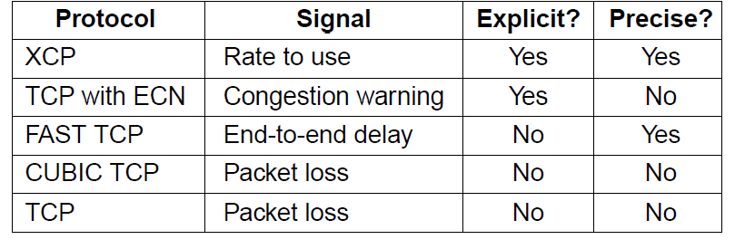
Regulating the Sending Rate (3)
Different congestion signals the network may use to tell the transport endpoint to slow down (or speed up)

Slide 42
Regulating the Sending Rate (3)
If two flows increase/decrease their bandwidth in the same way when the network signals free/busy they will not converge to a fair allocation.
Additive and multiplicative bandwidth adjustments.

Slide 43
Regulating the Sending Rate (4)
The AIMD (Additive Increase Multiplicative Decrease) control law does converge to a fair and efficient point!
In the absence of congestion sender should increase the rate
In the presence of congestion signal senders to decrease the rate
TCP uses AIMD for this reason
Additive Increase Multiplicative Decrease (AIMD) control law.

Slide 44
Wireless Issues
Wireless links lose packets due to transmission errors
Do not want to confuse this loss with congestion
Or connection will run slowly over wireless links!
Strategy:
Wireless links use ARQ, which masks errors
Congestion control over a path with a wireless link.

Slide 45
Internet Protocols – UDP
Introduction to UDP »
Remote Procedure Call »
Real-Time Transport »

Slide 46
Introduction to UDP (1)
UDP (User Datagram Protocol) is a shim over IP
Header has ports (TSAPs), length and checksum.
The UDP header.

Slide 47
Introduction to UDP (2)
Checksum covers UDP segment and IP pseudoheader
Fields that change in the network are zeroed out
Provides an end-to-end delivery check
The IPv4 pseudoheader included in the UDP checksum.

Slide 48
RPC (Remote Procedure Call)
RPC connects applications over the network with the familiar abstraction of procedure calls
Stubs package parameters/results into a message
UDP with retransmissions is a low-latency transport
Steps in making a remote procedure call. The stubs are shaded.

Slide 49
Real-Time Transport (1)
RTP (Real-time Transport Protocol) provides support for sending real-time media over UDP
Often implemented as part of the application
(a) The position of RTP in the protocol stack. (b) Packet nesting.

Slide 50
Real-Time Transport (2)
RTP header contains fields to describe the type of media and synchronize it across multiple streams
RTCP sister protocol helps with management tasks
The RTP header.

Slide 51
Real-Time Transport (3)
Buffer at receiver is used to delay packets and absorb jitter so that streaming media is played out smoothly
Smoothing the output stream by buffering packets.

Slide 52
Real-Time Transport (3)
High jitter, or more variation in delay, requires a larger playout buffer to avoid playout misses
Propagation delay does not affect buffer size
(a) High jitter. (b) Low jitter.

Slide 53
The Internet Transport Control Protocols: TCP
TPC (transport Control Protocol) is designed to provide reliable connection over unreliable internetwork.
Internetwork
Different topologies, bandwidths, delays, packet sizes, and other parameters.
TCP is designed to be robust against many types of failures.
The TCP stream may accept user data stream from local processes, breaks them up into pieces not exceeding 64KB (fits iin the Ethernet frame) and sends this piece as a separate TCP datagram.
When datagrams arrive at a machine, they are given to the TCP entity, which reconstructs the original byte streams.
The IP layer gives no guarantee that datagrams will be delivered properly and any indication of how fast these will be delivered.

Slide 54
The Internet Transport Control Protocols: TCP
It is up to the TCP to send datagrams fast enough to make enough capacity but not cause congestion and to timeout and retransmit messages that are not delivered.
It should also assemble in the order.

Slide 55
The Internet Transport Control Protocols: TCP
The TCP service model »
The TCP segment header »
TCP connection establishment »
TCP connection state modeling »
TCP sliding window »
TCP timer management »
TCP congestion control »

Slide 56
The TCP Service Model (1)
TCP service is obtained by both the sender and the receiver creating end points called sockets.
Each socket has a socket number consisting of of IP address and port number of the machine.
Port is the TCP name for a TSAP.
A connection must be explicitly established between a socket on one machine and a socket on other machine.
Port numbers below 1024 are reserved for well-known services.
They can only be started by privileged users
Other port numbers 1024 to 49151 are reserved for unprivileged users.

Slide 57
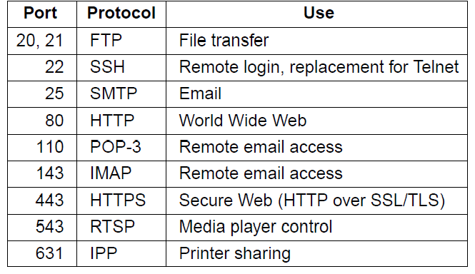
The TCP Service Model (1)
TCP provides applications with a reliable byte stream between processes; it is the workhorse of the Internet
Popular servers run on well-known ports

Slide 58
The TCP Service Model (2)
Applications using TCP see only the byte stream [right] and not the segments [left] sent as separate IP packets
(a) Four 512-byte segments sent as separate IP datagrams. (b) The 2048 bytes of data delivered to the application in a single call.

Slide 59
Overview of The TCP Protocol
Data is exchanged in the form is segments.
Each segment has 20 byte header +optional part followed by data.
Each segment must fit into 65515 byte payload (including header).
Basic protocol
Sliding window protocol with a dynamic window size
When a sender transmits a segment, it also starts a timer.
The receiver send ack segment with the expected sequence number.
If the sender timer goes off, before the ack is received, the sender retransmits the message again.
Issues
Out of order arrival of segments
Sender times out and retransmits

Slide 60
The TCP Segment Header
TCP header includes addressing (ports), sliding window (seq. / ack. number), flow control (window), error control (checksum) and more.
The TCP header.

Slide 61
The TCP Segment Header
Port addresses
Sequence number
Ack number
TCP header length: number of 32-bit words in TCP header.
1 bit flags
CWR and ECE are used for signal congestion when ECN is used.
ECE is set to signal an ECN-Echo to a TCP sender.
CWR (Congestion Window Reduced) is set by sender to inform the receiver that it has reduced the load and can stop sending ECN-Echo
URG is set to 1 of the urgent pointer is used.
ACK is set to one to indicate ACK is valid.
PSH it indicated pushed data. Do not wait for complete data.
RST bit is set to abruptly reset connection.
SYN bit is used to establish connection.
FIN bit is used to release connection.

Slide 62
Overview of The TCP Protocol
Window-size (WIN) tells how many bytes may be sent starting at the byte acknowledged.
If WIN=0, the sender must stop.
Options
MSS (Maximum segment size)
Using larger segment is better as the header data can be amortized over more data
Timestamp
SACK (Selective acknowledgement)
Lets the receiver to send a ranges of sequence numbers that it has received.

Slide 63
TCP Connection Establishment
TCP sets up connections with the three-way handshake
Release is symmetric, also as described before
TCP connection establishment in the normal case.
(b) Simultaneous connection establishment on both sides.

Slide 64
TCP Connection Release
To release a connection, either party can send a TCP segment with the FIN bit set.
When FIN is acknowledged, the direction is shutdown.
Other direction may continue.
To avoid two-army problem, timers are used
If a response to a FIN is not forthcoming within two packet lifetimes, the sender pf FIN releases the connection.
The other side will time out as well.

Slide 65
TCP Connection State Modeling (1)
The TCP connection finite state machine has more states than our simple example from earlier.
State | Description
CLOSED | No connection is active or pending
LISTEN | The server is waiting for an incoming call
SYN RCVD | A connection request has arrived; wait for ACK
SYN SENT | The application has started to open a connection
ESTABLISHED | The normal data transfer state
FIN WAIT 1 | The application has said it is finished
FIN WAIT 2 | The other side has agreed to release
TIME WAIT | Wait for all packets to die off
CLOSING | Both sides have tried to close simultaneously
CLOSE WAIT | The other side has initiated a release
LAST ACK | Wait for all packets to die off
The states used in the TCP connection management finite state machine.

Slide 66
TCP Connection State Modeling (2)
TCP connection management finite state machine. The heavy solid line is the normal path for a client. The heavy dashed line is the normal path for a server. The light lines are unusual events. Each transition is labeled with the event causing it and the action resulting from it, separated by a slash.

Slide 67
TCP Sliding Window (1)
TCP adds flow control to the sliding window as before
ACK + WIN is the sender’s limit
Window management in TCP.

Slide 68
TCP Sliding Window
If the sender transmits 2048 data, receiver stores in the buffer and sends ack.
Sender sends ACK and WIN=2048
Sender sends another 2KB.
As the buffer is full, receiver sends ack with WIN=0
Sender should stop sending
Sender resumes after receiver send ACK with WIN=2048.
Window probe
Sender may send 1-byte segment to force the receiver to renounce the next byte expected.
This is to prevent the deadlock, if the window updates ever gets lost.

Slide 69
TCP Sliding Window..
Senders need not transmit data as soon as it receives from the application.
Receivers need not send ACKs as soon as possible.
This freedom can be used to improve performance.
Issue:
some times each character creates a 21 byte segment, which it gives to IP 41-byte IP datagram.
At the receiver side, TCP immediately sends a 40-byte ack.
162 bytes of bandwidth are used and four segments are sent for each character typed.

Slide 70
TCP Sliding Window..
Solution: Delayed acks.
Delay ack up to 500 msec.
But if sender sends small packets, we will have the same problem.
Nagle’s algorithm
Send the first piece and buffer the rest until the first piece is ack.
Send all the buffered data in one TCP segment.
This is widely used algorithm, but for some applications, like interactive games, it is not applicable.
Silly window syndrome
Receiving end only processes one byte at a time.
Clark’s algorithm
Wait until decent amount of space is available and advertise that instead.

Slide 71
TCP Sliding Window (2)
Need to add special cases to avoid unwanted behavior
E.g., silly window syndrome [below]
Silly window syndrome.
Receiver application reads single bytes, so sender always sends one byte segments

Slide 72
TCP Timer Management
TCP estimates retransmit timer from segment RTTs
Tracks both average and variance (for Internet case)
Timeout is set to average plus 4 x variance
(a) Probability density of acknowledgement arrival times in the data link layer. (b) Probability density of acknowledgement arrival times for TCP.

Slide 73
TCP Timer Management
Probability density function varies significantly.
Variance is significant.
Things can change quickly.
Change T based on the performance
Jocobson algorithm
TCP maintains a variable SRTT (Smoothened round trip time)
TCP measures how long the ack took
It updates SRTT = α SRTT+(1- α ) SRTT
The formula is called EWMA (exponentially Weighted Moving Average).
Improved formula
Sensitive to variance in round trip times

Slide 74
TCP Timer Management
Two more timers
Persistence timer
Receiver sends ack asking sender to wait.
Later receiver updates the window, the packet with the update is lost
Situation: Both sender and receiver are waiting.
When persistence time goes off, the sender retransmits the probe. If it is still 0, the timer is initialized and cycle repeats
Keepalive timer
If the connection is idle for a long time, one side will check whether the other side is live or not. If iit fails to respond, the connection is terminated.

Slide 75
TCP Congestion Control (1)
TCP uses AIMD with loss signal to control congestion
Implemented as a congestion window (cwnd) for the number of segments that may be in the network
Uses several mechanisms that work together

Slide 76
TCP Congestion Control (2)
Congestion window controls the sending rate
Rate is cwnd / RTT; window can stop sender quickly
ACK clock (regular receipt of ACKs) paces traffic and smoothes out sender bursts
A burst of packets from a sender and the returning ack clock.

Slide 77
TCP Congestion Control (3)
Slow start grows congestion window exponentially
Doubles every RTT while keeping ACK clock going
Slow start from an initial congestion window of one segment.

Slide 78
TCP Congestion Control (4)
Additive increase grows
cwnd slowly
Adds 1 every RTT
Keeps ACK clock
Additive increase from an initial congestion window of one segment.

Slide 79
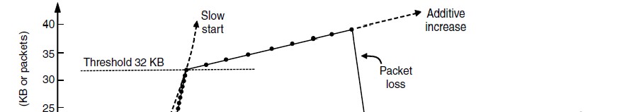
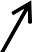
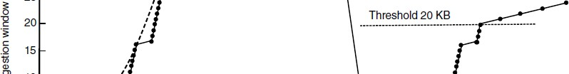
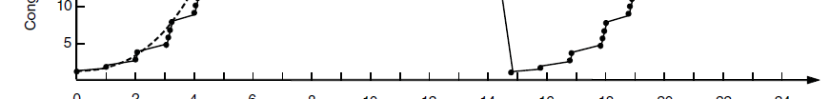
TCP Congestion Control (5)
Slow start followed by additive increase (TCP Tahoe)
Threshold is half of previous loss cwnd
Loss causes timeout; ACK clock has stopped so slow-start again

Slide 80
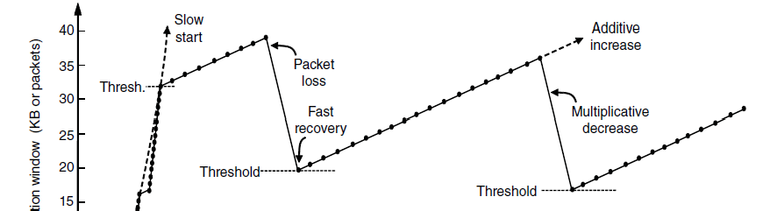
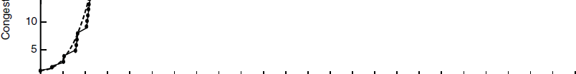
TCP Congestion Control (6)
With fast recovery, we get the classic sawtooth (TCP Reno)
Retransmit lost packet after 3 duplicate ACKs
New packet for each dup. ACK until loss is repaired
The ACK clock doesn’t stop, so no need to slow-start

Slide 81
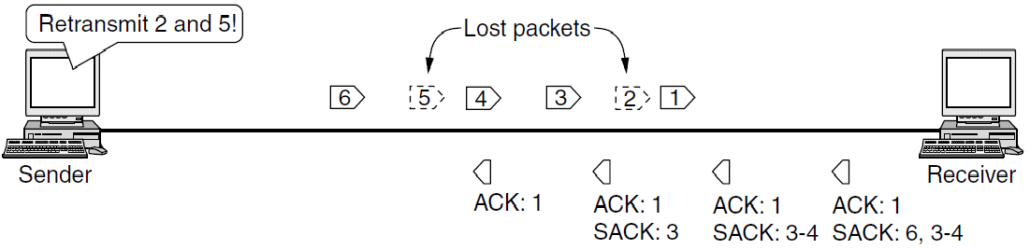
TCP Congestion Control (7)
SACK (Selective ACKs) extend ACKs with a vector to describe received segments and hence losses
Allows for more accurate retransmissions / recovery
No way for us to know that 2 and 5 were lost with only ACKs

Slide 82
Delay Tolerant Networking
Assumption so far:
Sender and receiver are continuously connected by some working path.
Other applications
Space network where satellites pass in and out of range of ground stations.
Networks involve submarine, buses, mobile phones have a intermittent connectivity
DTNs (Delay Tolerant Networks) store messages inside the network until they can be delivered
DTNs (Delay Tolerant Networks) store messages inside the network until they can be delivered
This model accepts delays like postal system.
Several applications
Copying of data to data centers
Sending traffic during off times.
Doing backups at night
It is possible to send huge datasets during off-time.

Slide 83
DTN Architecture (1)
Messages called bundles are stored at DTN nodes while waiting for an intermittent link to become a contact
DTN nodes are are equipped with storage
Bundles might wait hours, not milliseconds as in routers
May be no working end-to-end path at any time
Delay-tolerant networking architecture.

Slide 84
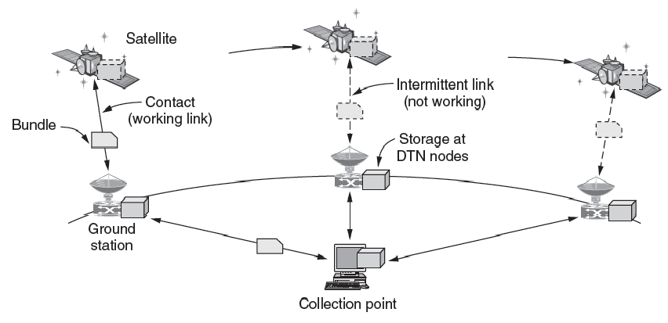
DTN Architecture (2)
Example DTN connecting a satellite to a collection point

Slide 85
Chapter 6
End

